Slide 1

Board Update
January 2, 2024

Slide 2
Introduction
Vision, Mission and Strategy
Brief Review of Facility Planning
  The “WHY”
  The “WHAT”
  The “HOW”
  The “WHO”
Vision, Mission and Strategy
Timeline and Next Steps
Outcomes

Slide 3

Our work is driven by…
Vision:
Future Ready: Establish DMPS as the premiere learning destination of choice for students, parents, staff and community.
Mission:
Design a facility plan to deliver a transformative education that transcends boundaries, disrupts legacy thinking, and prepares students for their future.
Strategy:
Immersive Multi-Cultural Learning Experiences
Access to World-Class Career and Technical Education (CTE)
Access to Rigorous Academic Suite
Wrap-around Holistic Child Development Programs & Supports

Slide 4





Why do we need a Facility Master Plan?
Forecasted
enrollment loss
Underutilization of buildings
Financial and
budget realties
Necessary reinvestment in facilities
Opportunity for program evaluation

Slide 5
3-Year Migration (with Virtual Students)
Out-Migration (students leaving the district)
In-Migration (students entering the district)
2020/21
2021/22
Elementary
2022/23
2020/21
2021/22
Middle
2022/23
2020/21
2021/22
High
2022/23
Source: RSP and Des Moines Public Schools
Definition
Out-Migration: Shows number of students in grade K to 11th that were attending the District in the previous year, but are not attending the District in the following year.
Main Takeaway:
2020/21 lost 2,854 students and gained 1,856 students; NET: -998
2021/22 lost 3,089 students and gained 2,188 students; NET: -901
2022/23 lost 2,842 students and gained 2,334 students; NET: -508
In-Migration: Shows number of students in grade 1st to 12th that are attending the District in the current year, but were not attending the District in the previous year.

Slide 6
Past Enrollment by Grade
Student data does not include alternative students, specialized programming, homeschool, preschool partner schools, or virtual campus students
Main Takeaway:
  Largest K-12 class in 2022/23 was 12th grade (2,292 students)
  Smallest K-12 class in 2022/23 – 7th grade (1,941 students)
  11th to 12th grade cohort typically sees student growth; all other cohorts on average decrease year to year
  Graduating senior class is similar or larger than the incoming Kdg class which could decrease future enrollment
*All past student data is exported from the district student database allowing the ability to do robust statistical analysis by student geography The student database export will not always align perfectly with the Official Counts (Statistically 99% greater match by grade)

Slide 7
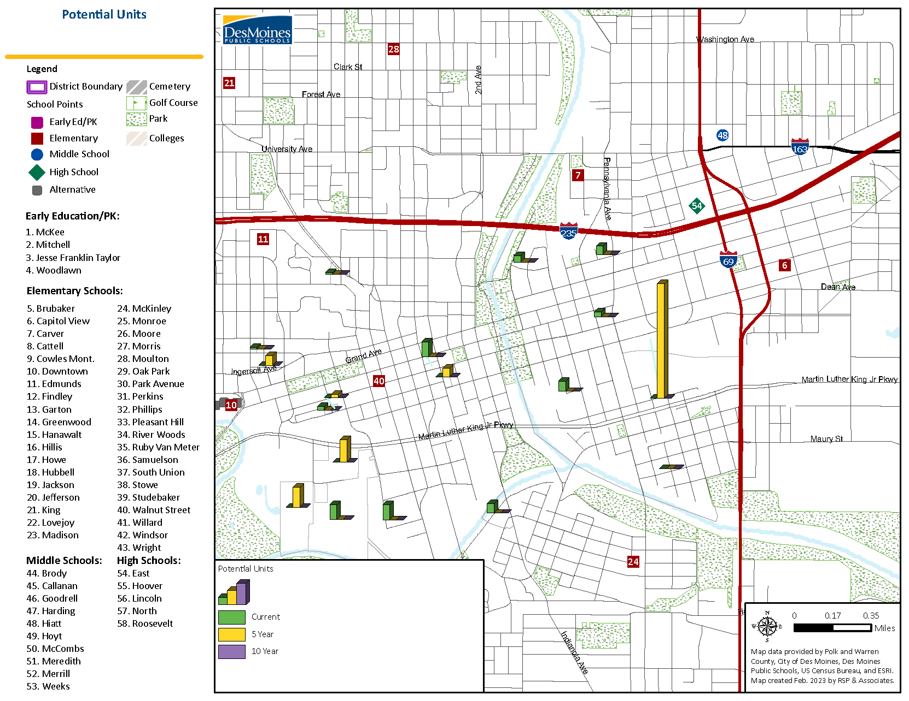
Potential Unit Development Map
MAIN TAKEAWAY:
Purple Line: School District Boundary
Green: Current potential units
Yellow: 5-year potential units
Purple: 10-year potential units
There is significant potential for more housing in downtown Des Moines.

Slide 8
Birth Rate Information
Student data does not include alternative students, specialized programming, homeschool, preschool partner schools, or virtual campus students
Source: Iowa Department of Public Health (IDPH) and Des Moines Public Schools
Live Births per Year
Past Kdg students
Projected Low Kdg students
Projected High Kdg students
  Main Takeaway
  Polk County live births have decreased by more than 500 births since the peak in 2015
3-year average of 56 less live births per year
  For the kindergarten classes to maintain 2,300 students, DMPS will need to increase their share of Polk County live births

Slide 9
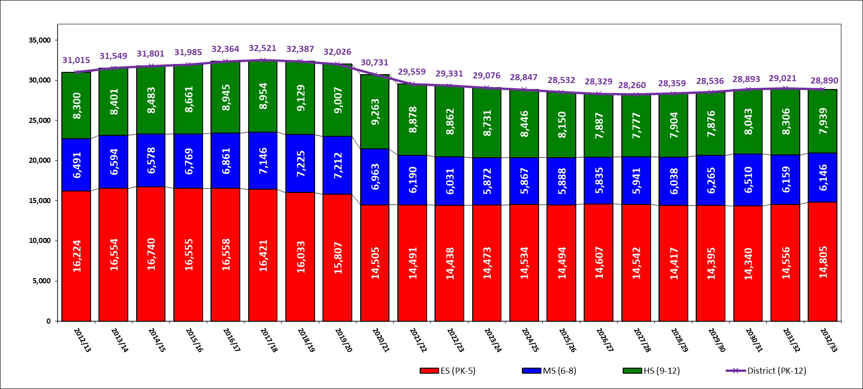
Past, Current, & Future Enrollment
Student data does not include alternative students, specialized programming, homeschool, preschool partner schools, or virtual campus students
Past Enrollment
First 5-Year
Second 5-Year
Market Forecast
Source: Des Moines Public Schools and RSP & Associates, LLC March 2023 Projection Model
First 5-Year Outlook (2023/24 to 2027/28) | Second 5-Year Outlook (2028/29 to 2032/33)
District: Decrease by over 1,000 students | District: Increase by an additional 620 students
Elementary: Increase by over 100 students | Elementary: Increase by an additional 260 students
Middle School: Decrease by about 90 students | Middle School: Increase by an additional 200 students
High School: Decrease by over 1,000 students | High School: Increase by an additional 160 students
*All past student data is exported from the district student database allowing the ability to do robust statistical analysis by student geography The student database export will not always align perfectly with the Official Counts (Statistically 99% greater match by grade)

Slide 10
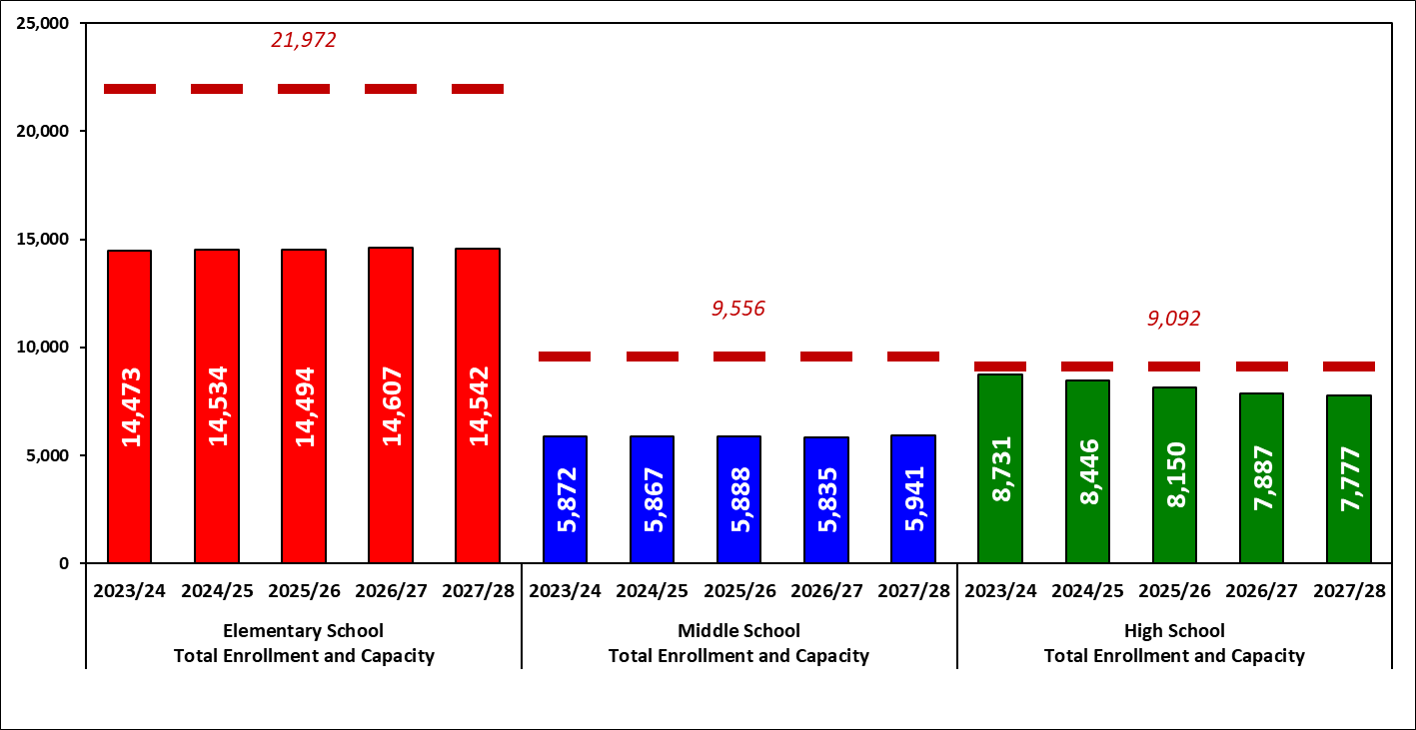
Enrollment and Utilization (5-Year)
Student data does not include alternative students, specialized programming, homeschool, preschool partner schools, or virtual campus students
Market Forecast
Source: Des Moines Public Schools and RSP & Associates, LLC March 2023 Projection Model
Main Takeaway:
ES capacity can serve almost 22,000 students; 2027/28 enrollment is projected to utilize 66% of ES capacity
MS capacity can serve over 9,500 students; 2027/28 enrollment is projected to utilize 62% of MS capacity
HS capacity can serve over 9,000 students; 2027/28 enrollment is projected to utilize 86% of ES capacity
Many schools are forecasted under 70% of building capacity creating potential utilization and staffing challenges over the next decade

Slide 11
Facility Condition Assessment
The District has hired BBS Architects/Engineers to perform Facility Condition Assessment on all the buildings in the district. Results from this study will be guiding measure that the committee will utilize throughout this process.
Facility Condition Assessments will review:
Facility utilization
Determine facility condition
Assist RSP & DMPS in determining 2023/24 functional building capacities

Slide 12

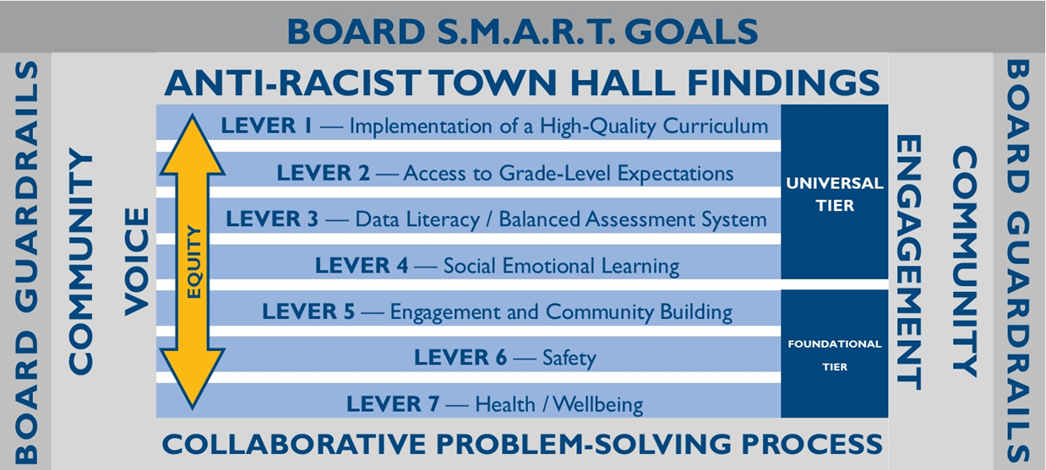
What is a Facility Master Plan?
A long-range planning process that utilizes local input, credible data, and district resources to…
Establish future of facilities
Create financial stability in the district
Ensure district resources are distributed equitably to all students
A Facility Master Plan may include:
Adjustment of school boundaries
New schools
Building additions
School consolidation
Change to grade configuration

Slide 13
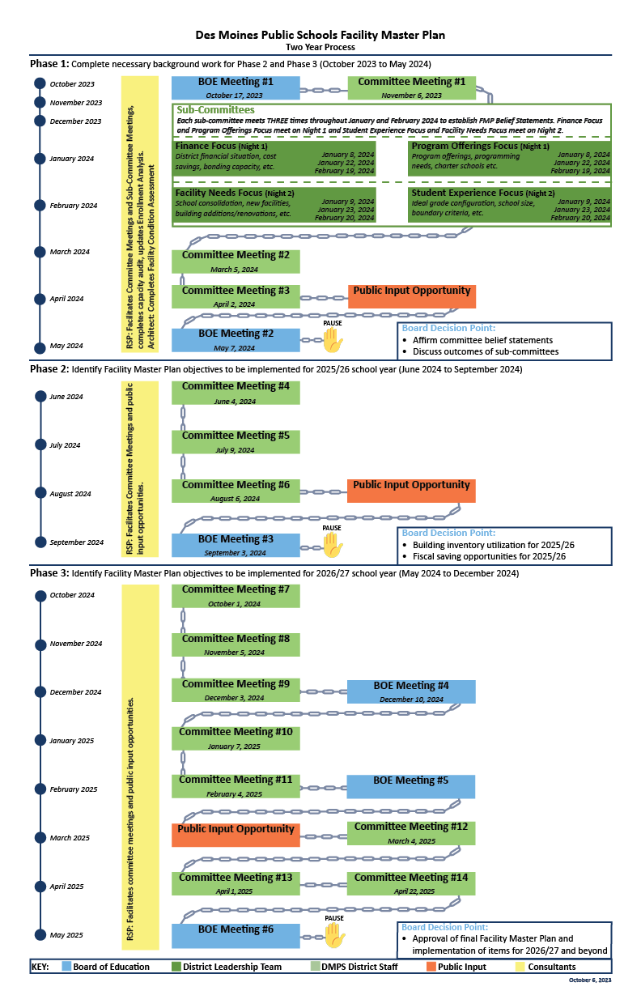
The How (the Plan)
Phase 1 (Oct. 2023 to May 2024):
Two BOE meetings
Three committee meetings
Twelve sub-committee meetings
One public input opportunity
Phase 2 (June 2024 to September 2024):
One BOE meetings
Three committee meetings
One public input opportunity
Phase 3 (October 2024 to May 2025):
Three BOE meetings
Eight committee meetings
One public input opportunity

Slide 14

Phase 1 Objectives
Phase 1
BOE Meeting #1
October 17, 2023
Committee Meeting #1
November 6, 2023
Each sub-committee meets THREE times on back-to-back nights:
Finance and Program Offerings meet on Night 1
Student Experience and Facility Needs meet on Night 2
Objectives:
Educate members through subcommittees
Finalize belief statements from each subcommittee
Seek community input on committee progress
Provide Board updates on progress and receive validation of belief statements
Main Takeaways:
Phase 1 is the fundamental starting point to potential solutions
The subcommittee’s purpose is on creating the belief statements
Each subcommittee will create 3-4 belief statements to guide how the Facility Master Plan will address finances, programs, facilities, and student experience
The Board will receive committee belief statement in a report and provide feedback
Board of Education operates as Student Outcome focused Governance (Allows administration and committee to work toward a decision)
Subcommittee Finance Focus (Night 1)
District financial situation
Cost savings
Bonding Capacity
January 8, 2024
January 22, 2024
February 19, 2024
Subcommittee Program Offerings Focus (Night 1)
Program Offerings
Programming Needs
Charter Schools
January 8, 2024
January 22, 2024
February 19, 2024
Subcommittee Facility Needs Focus (Night 2)
School consolidation
New facilities/additions
Facility renovations
January 8, 2024
January 22, 2024
February 19, 2024
Subcommittee Student Experience Focus (Night 2)
Grade configuration
School size
Boundary criteria
January 8, 2024
January 22, 2024
February 19, 2024
Committee Meeting #2
March 5, 2024
Committee Meeting #3
April 2, 2024
Public Input Opportunity
BOE Meeting #2
May 7, 2024

Slide 15



WHO is involved in the Facility Master Plan?
PROJECT CO-LEAD: DMPS
Responsibilities:
Facilitation of committee meetings
Education Specifications
Meeting Logistics
DMPS COMMITTEE: YOU!
Responsibilities:
Attend committee meetings
Provide feedback to facilitators
Work towards committee consensus
PROJECT CO-LEAD: RSP & Associates
Responsibilities:
Facilitation of committee meetings
Enrollment and demographic studies of student data
Boundary analysis and concept creation
FMP PROJECT ARCHITECT: BBS Architects/Engineers
Responsibilities:
Facility condition assessments

Slide 16
Our Committee:
Quick Facts:
Total Committee Membership = 85
% of Committee Members who are Parents = 50.1%
% of Committee Members who are Staff = 38%
% of Committee Members who are Admin = 10.6%
% of Committee Members who Community/Business Partners = 21.7%
% of Committee Members who are Students = 10.5%
Racial Representation compared to that of Students:
Asian = 10.5%/7.9%
Black A/A = 21.2%/20.7%
Hispanic/LatinX = 29.4%/30.2%
Multi-Race = 7%/6.9%
White = 31.76%/33.6%
Native American/Pacific Islander = 1.17%/.2%
Prefer Not to Say = 2.4%
Geographic Representation:
East HS = 17.6%
Hoover HS = 11.76%
Lincoln HS = 10.5%
North HS = 16.47%
Roosevelt HS= 11.76%
Districtwide = 17.6%
Age Range:
<18 = 9.41%
19-30 = 9.41%
31-45 = 45.88%
46-60 = 31.76%
>60 = 1.17%
Prefer Not to Say = 2.3%

Slide 17
Subcommittee #1 – Finance
Finance Subcommittee Members will:
Engage in conversations around District budget and financial stability to achieve Facility Master Plan objectives. Topics may include:
  General Fund
  Physical Plant & Equipment Levy Fund (PPEL)
  Secure and Advance Vision for Education Fund (SAVE)
  Education Savings Account (ESA)
  Tax Base Valuations
Discuss financing improvements to existing schools and possible future schools
Potential Outcomes of Subcommittee:
How financial situation connects to academic achievement
Capital dollars strategy can help with general dollars
Cost per pupil per building
District bonding capacity
Timing of other city/county projects/taxes

Slide 18
Subcommittee #2 – Facility Needs
Facility Need Subcommittee Members will:
Engage in conversations around key elements to discuss utilization of district facilities. Topics may include:
  Capital Improvement Planning
  Facility Condition Assessments
  Alignment of Facility Use with Program Offerings
Potential Outcomes of Subcommittee:
Facility efficiency/consolidation
Improve educational programming
Revitalization of facility conditions
Consider how potential renovations may improve students’ academic ability
Consider what the ideal school capacity is from a facility/utilization perspective
Reasoning/triggers to determine when it is most appropriate to build new, renovate, and/or repurpose school facilities

Slide 19
Subcommittee #3 – Program Offerings
Program Offerings Subcommittee Members will:
Engage in conversations around offerings that may influence existing and future facility designs and staffing needs. Topics may include:
  Innovative learning
  21st Century learning
  Special programming needs
  English language learning needs
Potential Outcomes of Subcommittee:
  Blueprint for 21st Century learning
  Closing academic achievement gap
  Special/district programming (SPED, gifted) Early childhood = Think Big
  Technology plan
  District and community program values
  Other school programming options (K-8, Magnet, Early childcare)

Slide 20
Subcommittee #4 – Student Experience
Student Experience Subcommittee Members will:
Engage in conversations around how our students attend DMPS schools. Topics may include:
  Grade level configuration
  Elementary, middle, and high school boundaries
  School size
Potential Outcomes of Subcommittee:
  Framework of community values
  Preferred prioritization Boundary criteria
  Reasoning/Basis for change (grade configuration, grand center, transitions)
  How Facility Master Plan objective improve the student experience
  Consider what the ideal school capacity is from a student experience perspective

Slide 21

Since we last met…
Finalize Formation of Committee Membership
Data Requests and Research
Initial Development of Subcommittee Values and Commitments
Facility Tours:
  December 9th – Greenwood & Edmunds Elementary Schools
  December 16th – Greenwood & Edmunds Elementary Schools
  January TBD –
  February 17th – Waukee Schools

Slide 22

Board Update
January 2, 2024

