Slide 1
Committee Updates
January 10/11, 2024

Slide 2
Since we met last…
November 6th – 1st Committee Meeting
Finalize Formation of Committee Membership
Data Requests and Research Compilation
Facility Tours:
December 9th – Greenwood & Edmunds Elementary Schools
December 16th – Greenwood & Edmunds Elementary Schools

Slide 3
Coming up…
January 10/11 – Subcommittee Meetings
January 23/23 – Subcommittee Meetings
School Tours:
January 27th – Secondary Schools in DMPS
February 17th – Waukee Schools
February 19/20 – Subcommittee Meetings
March 5 – Full Committee Meeting

Slide 4
Our Agenda
Welcome & Committee Updates (6pm)
Vision, Mission and Strategy – anchor document
Problem Statement & Opportunity Statement
Data Access – Stoplight Report
Committee Membership Publication
Sub-committee Breakouts (6:20pm)
Finance
Programming
Facilities
Student Experience
Closing Remarks (8pm)

Slide 5
DMPS School Board seeking thoughts and input…
The School Board invites you to take part in a brief online survey to help shape the direction of DMPS goals for the next three years. Your insights will assist Board members in identifying strengths as well as areas for improvement within the district.
The survey responses will be carefully collected, analyzed, and prioritized. The School Board, Superintendent, and district staff will review your input alongside other essential district data as a part of this process. This effort will result in setting goals and guidelines for the school district, which are monitored in order to continually best serve the students of Des Moines.
Please take a few minutes to share your thoughts in the online survey, available in multiple languages. We appreciate your time.
Click here to complete the online survey

Slide 6
Our work is driven by…
Vision:
Future Ready: Establish DMPS as the premiere learning destination of choice for students, parents, staff and community.
Mission:
Design a facility plan to deliver a transformative education that transcends boundaries, disrupts legacy thinking, and prepares students for their future.
Strategy:
Immersive Multi-Cultural Learning Experiences
Access to World-Class Career and Technical Education (CTE)
Access to Rigorous Academic Suite
Wrap-around Holistic Child Development Programs & Supports

Slide 7
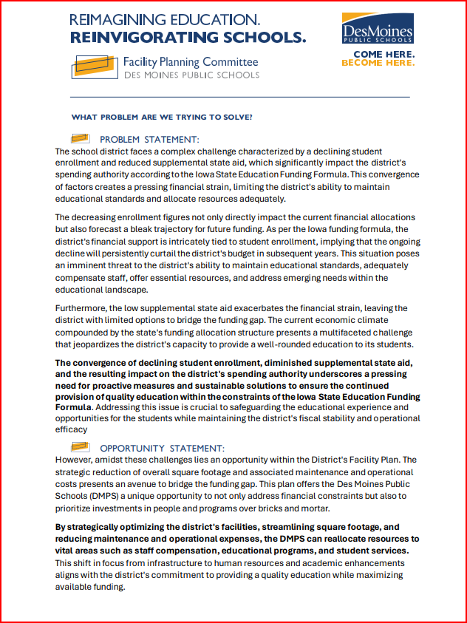
What problem are we trying to solve?
Problem Statement
The convergence of declining student enrollment, diminished supplemental state aid, and the resulting impact on the district's spending authority underscores a pressing need for proactive measures and sustainable solutions to ensure the continued provision of quality education within the constraints of the Iowa State Education Funding Formula.
Opportunity Statement
By strategically optimizing the district's facilities, streamlining square footage, and reducing maintenance and operational expenses, the DMPS can reallocate resources to vital areas such as staff compensation, educational programs, and student services to achieve student outcome goals.

Slide 8
Phase 1 Objectives
Phase 1
BOE Meeting #1
October 17, 2023
Committee Meeting #1
November 6, 2023
Each sub-committee meets THREE times on back-to-back nights:
Finance and Program Offerings meet on Night 1
Student Experience and Facility Needs meet on Night 2
Objectives:
Educate members through subcommittees
Finalize belief statements from each subcommittee
Seek community input on committee progress
Provide Board updates on progress and receive validation of belief statements
Main Takeaways:
Phase 1 is the fundamental starting point to potential solutions
The subcommittee’s purpose is on creating the belief statements
Each subcommittee will create 3-4 belief statements to guide how the Facility Master Plan will address finances, programs, facilities, and student experience
The Board will receive committee belief statement in a report and provide feedback
Board of Education operates as Student Outcome focused Governance (Allows administration and committee to work toward a decision)
Subcommittee Finance Focus (Night 1)
District financial situation
Cost savings
Bonding Capacity
January 10, 2024
January 22, 2024
February 19, 2024
Subcommittee Program Offerings Focus (Night 1)
Program Offerings
Programming Needs
Charter Schools
January 10, 2024
January 22, 2024
February 19, 2024
Subcommittee Facility Needs Focus (Night 2)
School consolidation
New facilities/additions
Facility renovations
January 11, 2024
January 23, 2024
February 20, 2024
Subcommittee Student Experience Focus (Night 2)
Grade configuration
School size
Boundary criteria
January 11, 2024
January 23, 2024
February 20, 2024
Committee Meeting #2
March 5, 2024
Committee Meeting #3
April 2, 2024
Public Input Opportunity
BOE Meeting #2
May 7, 2024

Slide 9
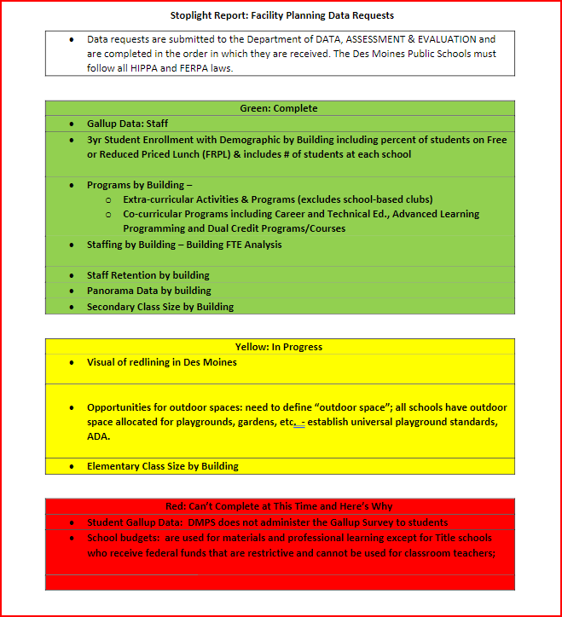
Data Requests: Stoplight Report
Completed Requests:
In-Progress Requests:
Can’t Complete the Request at this Time, and Here’s WHY:

Slide 10
Committee Membership Publication…
We will publish the names of committee members on the district website. If you desire to not have your name published for any reason, please let me know. The reasons for this include:
So students, staff and community know whom to share their thoughts and voices with concerning the facility plan we develop
As a committee member, you are expected to be able to articulate and communicate the rationale for our collective decisions; YOU are the most instrumental and influential voice our community needs to hear
We will plan to publish names of committee members by end of day Monday, January 15th

Slide 11
Committee Updates
January 10/11, 2024

Slide 12
Subcommittee #1 – Finance
Finance Subcommittee Members will:
Engage in conversations around District budget and financial stability to achieve Facility Master Plan objectives. Topics may include:
General Fund
Physical Plant & Equipment Levy Fund (PPEL)
Secure and Advance Vision for Education Fund (SAVE)
Education Savings Account (ESA)
Tax Base Valuations
Discuss financing improvements to existing schools and possible future schools
Potential Outcomes of Subcommittee:
How financial situation connects to academic achievement
Capital dollars strategy can help with general dollars
Cost per pupil per building
District bonding capacity
Timing of other city/county projects/taxes

Slide 13
Subcommittee #2 – Facilities
Facility Need Subcommittee Members will:
Engage in conversations around key elements to discuss utilization of district facilities. Topics may include:
Capital Improvement Planning
Facility Condition Assessments
Alignment of Facility Use with Program Offerings
Potential Outcomes of Subcommittee:
Facility efficiency/consolidation
Improve educational programming
Revitalization of facility conditions
Consider how potential renovations may improve students’ academic ability
Consider what the ideal school capacity is from a facility/utilization perspective
Reasoning/triggers to determine when it is most appropriate to build new, renovate, and/or repurpose school facilities

Slide 14
Subcommittee #3 – Program Offerings
Program Offerings Subcommittee Members will:
Engage in conversations around offerings that may influence existing and future facility designs and staffing needs. Topics may include:
Innovative learning
21st Century learning
Special programming needs
English language learning needs
Potential Outcomes of Subcommittee:
Blueprint for 21st Century learning
Closing academic achievement gap
Special/district programming (SPED, gifted) Early childhood = Think Big
Technology plan
District and community program values
Other school programming options (K-8, Magnet, Early childcare)

Slide 15
Subcommittee #4 – Student Experience
Student Experience Subcommittee Members will:
Engage in conversations around how our students attend DMPS schools. Topics may include:
Grade level configuration
Elementary, middle, and high school boundaries
School size
Potential Outcomes of Subcommittee:
Framework of community values
Preferred prioritization Boundary criteria
Reasoning/Basis for change (grade configuration, grand center, transitions)
How Facility Master Plan objective improve the student experience
Consider what the ideal school capacity is from a student experience perspective

