Slide 1
Planning for
the Future
Des Moines Public Schools
Facility Plan
BOE Meeting #1
October 17, 2023

Slide 2
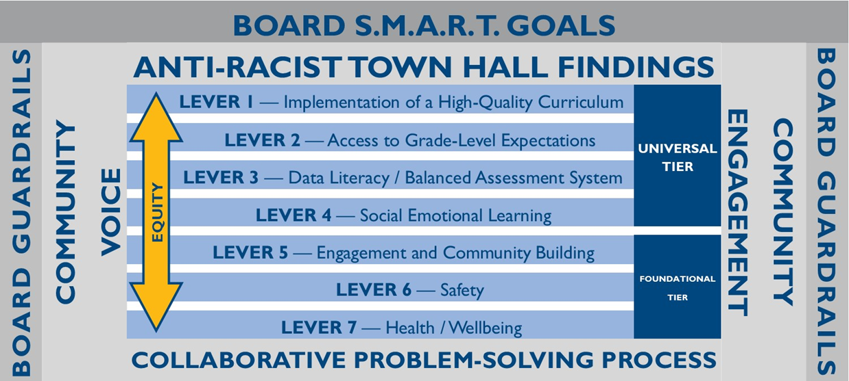
What is a Facility Master Plan?
A long-range planning process that utilizes local input, credible data, and district resources to…
Establish future of facilities
Create financial stability in the district
Ensure district resources are distributed equitably to all students
A Facility Master Plan may include:
Adjustment of school boundaries
New schools
Building additions
School consolidation
Change to grade configuration

Slide 3
Who is involved in the Facility Master Plan?
PROJECT CO-LEAD: DMPS
Responsibilities:
Facilitation of committee meetings
Education Specifications
Meeting Logistics
DMPS COMMITTEE:
Responsibilities:
Attend committee meetings
Provide feedback to facilitators
Work towards committee consensus
PROJECT CO-LEAD: RSP & Associates
Responsibilities:
Facilitation of committee meetings
Enrollment and demographic studies of student data
Boundary analysis and concept creation
FMP PROJECT ARCHITECT: BBS Architects/Engineers
Responsibilities:
Facility condition assessments
END GOAL: Provide a final recommendation of Facility Master Plan actions to the DMPS Board of Education for final adoption.

Slide 4
About RSP & Associates
Quick Facts:
Founded in 2003
Professional educational planning firm
Expertise in multiple disciplines (GIS, Planning, Facilitation)
Over 20 years of planning experience
Over 80 years of education experience
Over 20 years of GIS experience
Projection accuracy of 97% or greater
RSP Experience:
Regional Projects:
Ankeny Community School District
Facility Master Plan & Enrollment Analysis, 2022/23
RSP has worked with ACSD for the past 12 years
Cedar Rapids Community School District
Facility Master Plan & Enrollment Analysis, 2018/19
Waukee Community School District
Boundary & Enrollment Analysis, 2022/23
RSP has worked with WCSD for the past 12 years
Large-Scale Projects:
Kansas City Kansas Public Schools (KS)
Omaha Public Schools (NE)
Oklahoma City Public Schools (OK)
Rutherford County Schools (TN)
Wichita Public Schools (KS)
RSP Planning Team:
Robert Schwarz, CEO
Military, County, City, and School District Planner
University of Kansas – Master of Urban Planning (MUP)
American Institute of Certified Planners (AICP)
Accredited Learning Environment Planner (ALEP)
Ginna Wallace, Planner
University of Kansas – Master of Urban Planning (MUP)
American Institute of Certified Planners (AICP)
Dr. Dave Wilkerson, Education Consultant (Ph.D.)
Dr. Todd White, Education Consultant (Ed.D.)

Slide 5
Why do we need a Facility Master Plan?
Forecasted
enrollment loss
Underutilization of buildings
Financial and
budget realties
Necessary reinvestment in facilities
Opportunity for program evaluation

Slide 6
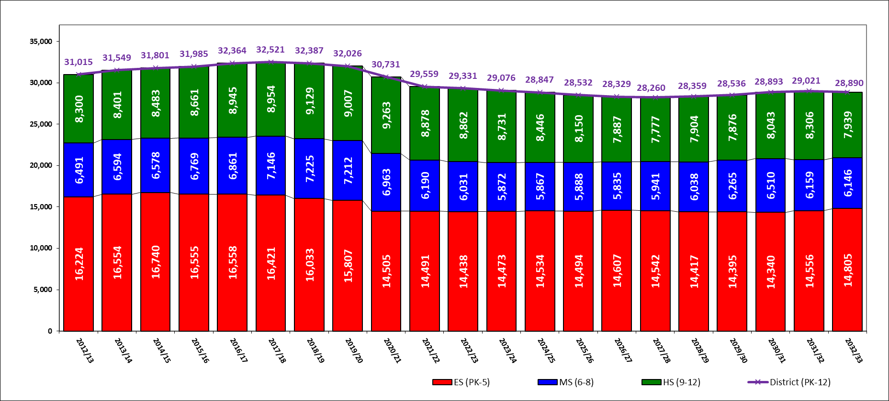
Past, Current, & Future Enrollment
Student data does not include alternative students, specialized programming, homeschool, preschool partner schools, or virtual campus students
Past Enrollment
First 5-Year
Second 5-Year
Market Forecast
Source: Des Moines Public Schools and RSP & Associates, LLC March 2023 Projection Model
First 5-Year Outlook (2023/24 to 2027/28) | Second 5-Year Outlook (2028/29 to 2032/33)
Total enrollment forecasted to decrease by over 1,000 students | Total enrollment forecasted to increase by an additional 620 students
PK-5 enrollment forecasted to increase by over 100 students | PK-5 enrollment forecasted to increase by an additional 260 students
6-8 enrollment forecasted to decrease by about 90 students | 6-8 enrollment forecasted to increase by an additional 200 students
9-12 enrollment forecasted to decrease by over 1,000 students | 9-12 enrollment forecasted to increase by an additional 160 students
*All past student data is exported from the district student database allowing the ability to do robust statistical analysis by student geography The student database export will not always align perfectly with the Official Counts (Statistically 99% greater match by grade)

Slide 7
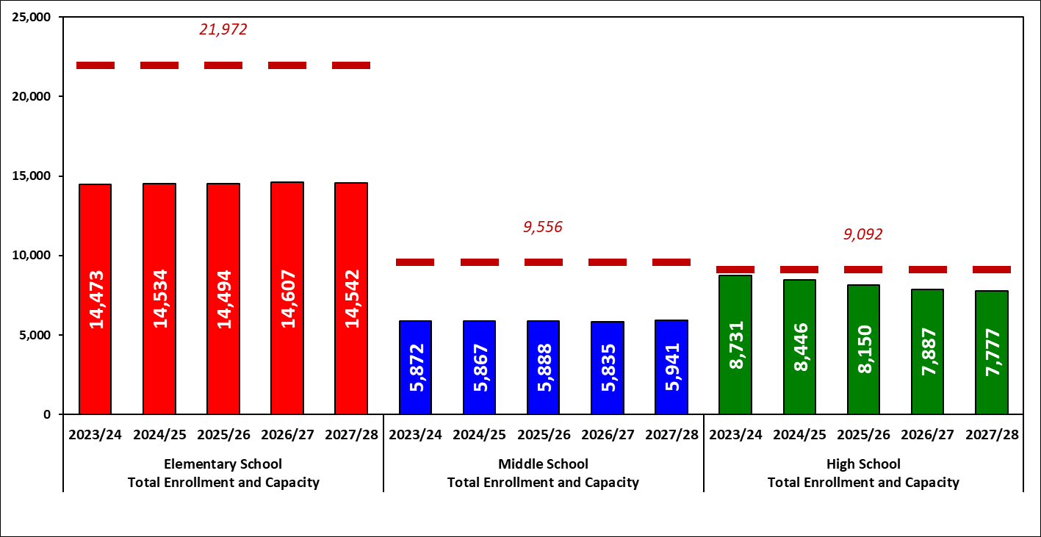
Enrollment and Utilization (5-Year)
Market Forecast
Source: Des Moines Public Schools and RSP & Associates, LLC March 2023 Projection Model
ES capacity can serve almost 22,000 students; 2027/28 enrollment is projected to utilize 66% of ES capacity
MS capacity can serve over 9,500 students; 2027/28 enrollment is projected to utilize 62% of MS capacity
HS capacity can serve over 9,000 students; 2027/28 enrollment is projected to utilize 86% of ES capacity
Many schools are forecasted under 70% of building capacity creating potential utilization and staffing challenges over the next decade

Slide 8
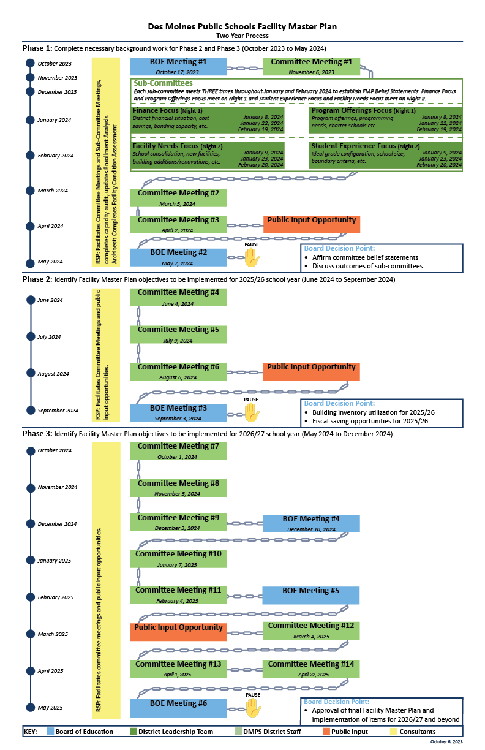
The Plan
Phase 1 (Oct. 2023 to May 2024):
Two BOE meetings
Three committee meetings
Twelve sub-committee meetings
One public input opportunity
Phase 2 (June 2024 to September 2024):
One BOE meetings
Three committee meetings
One public input opportunity
Phase 3 (October 2024 to May 2025):
Three BOE meetings
Eight committee meetings
One public input opportunity

Slide 9
Phase 1 Objectives
Establish BOE charge for committee
Establish scope of work
Education committee members through sub-committee focus:
Finance Focus
Student Experience Focus
Program Offerings Focus
Facility Needs Focus
Finalize committee belief statements from each sub-committee
Provide community input on committee progress
BOE update on progress and validation of belief statements

Slide 10
Questions?

