Slide 1
The Transition from Elementary to Middle School
Advanced Learning Program
Dr. Jolene Teske, Advanced Learning Program Supervisor

Slide 2
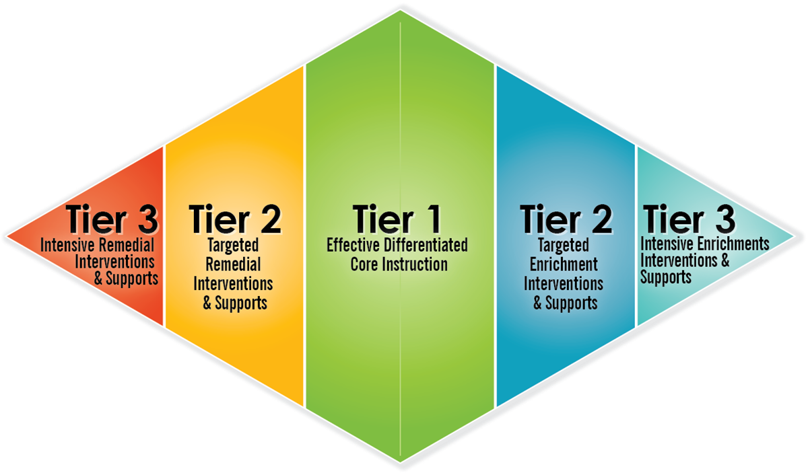
What is the Advanced Learning Program?
The Advanced Learning Program (ALP) is the bookend to the Special Education Program, the other end of the MTSS Diamond.
Advanced Learning Consultants partner with teachers to serve the needs of students who have needs beyond Tier 1 core instruction.
BOTH Special Education and Advanced Learning…
*identify students using multiple data points
*advocate for the needs of students
*tier students based on need
Special Education
Advanced Learners
Notes:
2 minutes
When thinking about the Advanced Learning Program, you can think about it as the bookend for Special Education or the other end of the MTSS Diamond. In looking at a traditional bell curve, there are outliers on both ends. Those ends are the Tiers 2 & 3 for both special education and advanced learning. We tier and serve students based on their needs outside what they receive in Tier 1 universal instruction. In fact, the role of advanced learning consultant is similar to the role of those supporting special education students.
Tier 2 students may need differentiation in content, process, or product. Tier 3 are sometimes served with content acceleration or full grade acceleration.

Slide 3
Elementary Advanced Learning Programming
Teacher Support
Frequent collaboration
Focus on depth and complexity
Pull-out individual/group work
Academic Support
Self-Advocacy Support
AND events such as …
Art Workshops
Battle of the Books
Creativity Night
Gold Star Reader
Math Competitions
Parent/Child Workshop
Science Fair
Showcase
Strategic Thinking Night

Slide 4
Middle School Advanced Learning Programming
Teacher Support
Frequent collaboration
Focus on depth and complexity
Pull-out individual/group work as schedules allow
Academic Support
Self-Advocacy Support
Starting in the Fall of 2023
Intense work with Math 6 teachers to extend the learning of students who need additional challenge in math
Course Selection and Academic Planning for 8th graders
AND events such as …
Art Workshops
Battle of the Books
Dance Workshops
Math Counts
Pentathlon

Slide 5
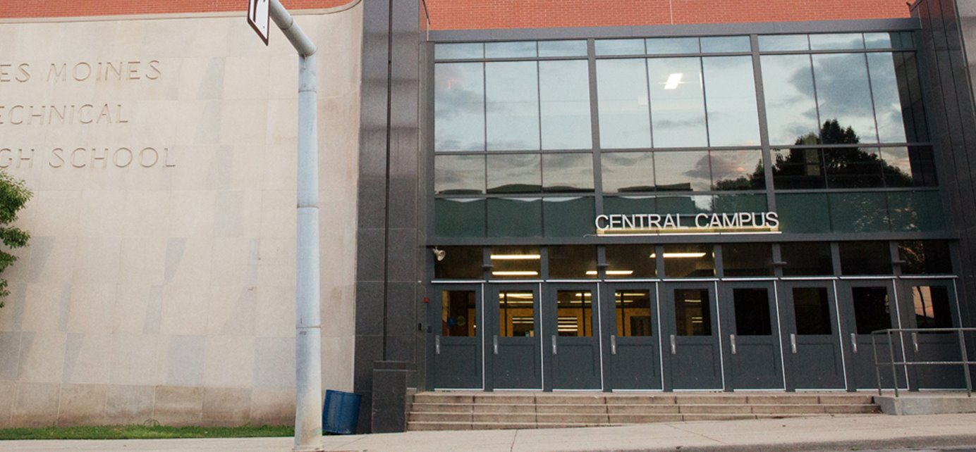
Central Campus | Central Academy
Side-by-Side and Connected by a Skywalk, but Two Distinct Programs

Slide 6
Central Campus | Central Academy
1800 Grand Avenue
Business
Communication Business
Education & Leadership
Engineering & Architecture
Environmental & Agricultural Sciences
Family & Consumer Sciences
Health Sciences
Skilled Trades
Technology & Systems Integration
Transportation
1912 Grand Avenue
AP Computer Science | Advanced Art
AP English | Advanced English
AP Mathematics | Advanced Mathematics
AP Science | Advanced Science
AP Social Studies | Advanced Social Science
AP World Languages | Advanced World Language
AP Capstone | 8th Grade Academy
7th Grade Prep Academy

Slide 7
Central Academy
7th Grade Prep Academy
8th Grade Academy
Unique Courses
Accelerated Core Pathway

Slide 8
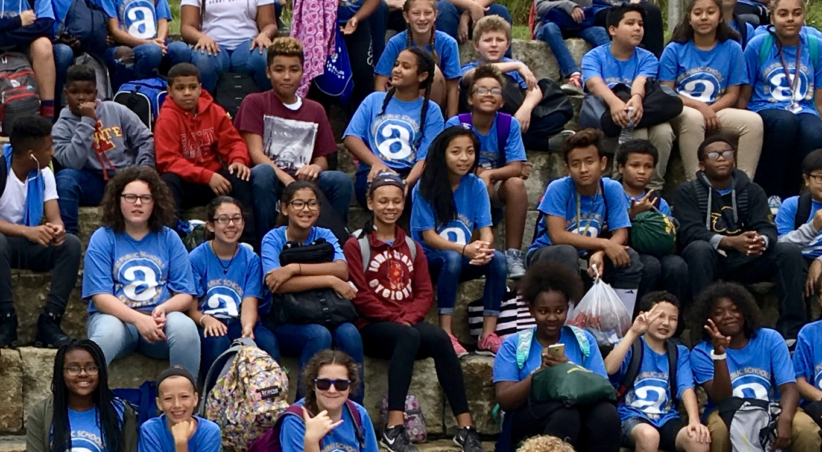
7th Grade Prep & 8th Grade Academy Identification
Competence | Confidence | Connection
Student Assessment Data
Teacher Rating Scale
In class performance through Standard-Referenced Grades
Notes:
Stephanie: Overview of the process and main categories of data.

Slide 9
The Advanced Learning Program is NOT about the label
Central Academy and Central Campus high school courses are open to all DMPS students who need them.
ALP Identification DOES NOT influence opportunities at Central Academy or Central Campus.
LABEL
Each DMPS middle school student, regardless of ALP identification, is screened for 7th and 8th Grade options at Central Academy.
Academy counselors advise students to help align students with courses that match their abilities and academic readiness.

Slide 10
The Advanced Learning Program is about the Academic Need…
of each student
in the specific building
at that point in time
compared to grade-level peers
It is fluid and everchanging

Slide 11
Questions?
If you have questions, please reach out to the AL Consultant in your student’s building or me:
Jolene Teske
jolene.teske@dmschools.org
242-8393

